Slide 1
The Exodus
Exodus 1-19
Moses, the Plagues, the Passover,
in the desert to Mt. Sinai

Slide 2
The Book of Exodus
Focused on two main narratives
Ch 1-15: liberation of Israel from Egyptian bondage
Ch 19-24: The revelation of the law at Mount Sinai
The second part depends on the first.
By redeeming the Israelite slaves from Egypt, the Lords earns the right to “enslave” them to himself through the covenant (Lev 25.42, 55)

Slide 3
Go Down Moses
Louis Armstrong Version
"And the LORD spake unto Moses, go unto Pharaoh, and say unto him, thus saith the LORD, Let my people go, that they may serve me." Exodus 8:1
Go down Moses
way down in Egypt land, tell old Pharaoh to Let My People Go!
Now, When Israel was in Egypt land... Let My People Go!
Oppressed so hard they could not stand... Let My People Go!
So the Lord said: 'Go down, Moses way down in Egypt land, tell old Pharaohs to Let My People Go!‘
So Moses went to Egypt land... Let My People Go!
He made all Pharaoh understand... Let My People Go!
Yes The Lord said 'Go down, Moses way down in Egypt land, tell old Pharaohs to Let My People Go!‘
Thus spoke the Lord, bold Moses said: Let My People Go!
'If not I'll smite, your firstborn's dead' Let My People Go!
Cause the Lord said 'Go down, Moses
way down in Egypt land, tell old Pharaoh to Let My People Go!‘
tell old Pharaoh to let My People Go 5
Notice the call and response
Learn more about Spirituals: http://ctl.du.e5du/spirituals/History/
https://www.youtube.com/watch?v=8JNCS27rtQ8

Slide 4
Ancient references
Stele of Hammurabi from Babylon (18th century BCE).
It records a deity giving laws to people that resemble Israel’s laws
Stele of Merneptah (1200s BCE)
It contains the first known extrabiblical reference to Israel’s existence. He claims to have devastated land of Canaan and its people.

Slide 5
Egyptian images of Semites making bricks
Exodus 5:4-14
Egyptian tomb paintings from around the 15th Century BCE. Showing Semitic people doing the same kind of work described in Exodus 5.

Slide 6
Ramses II (1290-1224 BCE)
Ramses II is thought by many to be the unnamed Pharaoh of the Exodus.
He had enormous power. Wears a royal headdress and his scepter symbolizes his absolute control of the state.

Slide 7
The Passover
Exodus 12
Slaughter a male, unblemished lamb: one per family
Eat it that night
Put its blood on the doorposts and lintel (above the door)
Eat it with unleavened bread (flat bread)
Eat it with bitter herbs
Roast it whole (roasting ensures that the blood is out) blood belongs to god. It’s a symbol of life)
Burn all leftovers
Eat it hurriedly
Blood is a sign and means the angel of death will pass over (12:13)

Slide 8
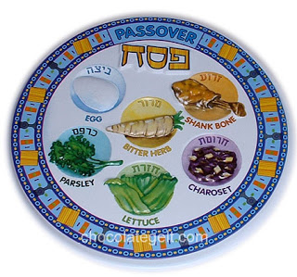
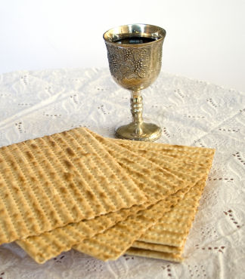
The Passover now
Roasted lamb shankbone: (zeroah), the lamb sacrifice made the night of the exodus.
Roasted egg: (baytsah) signifies springtime and a new beginning.
Maror (“bitter herb”): Recalls the bitterness of slavery.
Charoset: (“kha-ROH-set”), a sweet salad of apples, nuts, wine, and cinnamon that represents the mortar used by the Hebrew slaves to make bricks.
Karpas: Karpas a green vegetable dipped into salt water to represent the tears and sweat of slavery
Chazeret: The chazeret (“khah-ZER-et”) is a second bitter herb, also recalling the bitterness of slavery.
Matzah: matzah (unleavened bread)
Sweet wine: Represents blood of the sacrifice and the promises of redemption.

Slide 9
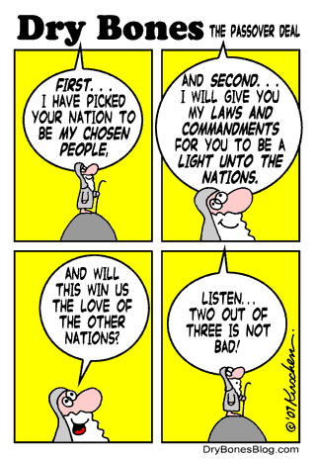
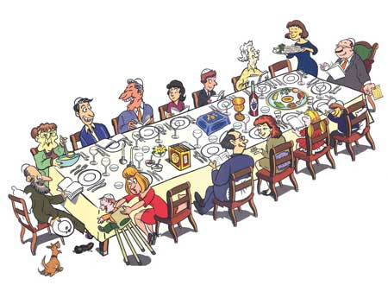

Slide 10
A possible escape route
This map shows a possible route the Israelites may have taken across the Sinai peninsula away from Egypt to the promised land that “flows with milk and honey.”

Slide 11
Tefillin (or phylacteries)
The Tefillin (in English, phylacteries) are small leather boxes with straps that can be tied on the arm and around the head. Inside are parchment which contain verses from four sections of the Torah.
The Tefillin worn on the arm represents the opportunity to serve God with the body through doing commandments, and the tefillin on the head represents the ability to serve God with the mind through study and belief.
Exodus 13:9 “It shall serve for you as a sign on your hand and as a reminder on your forehead, so that the teaching of the Lord may be on your lips; for with a strong hand the Lord brought you out of Egypt.”
See also Deuteronomy 6: 4-9 “Keep these words that I am commanding you today in your heart…. Bind them as a sign on your hand, fix them as an emblem on your forehead, and write them on the doorposts of your house and on your gates. “

Slide 12
The Song of Moses Exodus 15
(Notice examples of parallelism. It may have been sung in a call and response format)
Then Moses and the Israelites sang this song to the Lord:
‘I will sing to the Lord, for he has triumphed gloriously; horse and rider he has thrown into the sea. The Lord is my strength and my might, and he has become my salvation; this is my God, and I will praise him, my father’s God, and I will exalt him. The Lord is a warrior; the Lord is his name.

Slide 13
The Song of Moses (cont.)
‘Pharaoh’s chariots and his army he cast into the sea; his picked officers were sunk in the Red Sea. The floods covered them; they went down into the depths like a stone. Your right hand, O Lord, glorious in power— your right hand, O Lord, shattered the enemy. In the greatness of your majesty you overthrew your adversaries; you sent out your fury, it consumed them like stubble. At the blast of your nostrils the waters piled up, the floods stood up in a heap; the deeps congealed in the heart of the sea. The enemy said, “I will pursue, I will overtake, I will divide the spoil, my desire shall have its fill of them. I will draw my sword, my hand shall destroy them.” You blew with your wind, the sea covered them;

Slide 14
Complaints after leaving Egypt
Verse | Situation | Complaint | Response
14:11 | When Egyptian army is closing in. | “Was it because there were no graves in Egypt that you have taken us away to die in the wilderness?” | Pillar of fire protects them
15:24 | When the water is bitter and they cannot drink | And the people complained against Moses saying, “What shall we drink?” | Moses throws a piece of wood into the water and it becomes sweet
16:2 | When they feel hungry (they remember the fleshpots of Egypt) | “If only we had died by the hand of the Lord in the land of Egypt, when we sat by the fleshpots and ate our fill of bread; for you have brought us out into this wilderness to kill this whole assembly with hunger.” | Given quail at night and manna in the morning (Supernatural food), and rules about dealing with it.
17:3 | No water | “Why did you bring us out of Egypt, to kill us and our children and livestock with thirst?” | Moses strikes rock and water comes out

Slide 15
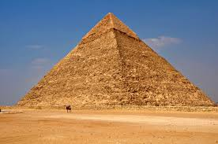
So You Wanna Go Back to Egypt by Keith Green
So you wanna go back to Egypt Where it's warm and secure Are sorry you bought the one way ticket When you thought you were sure You wanted to live in the land of promise But now it's getting so hard Are you sorry you're out here in the desert Instead of your own back yard
Eating leeks and onions by the Nile Ooh what breath for dining out in style Ooh, my life's on the skids Give me the pyramids

Slide 16
Well there's nothing do but travel And we sure travel a lot 'Cause it's hard to keep your feet from moving When the sand gets so hot And in the morning it's manna hot cakes We snack on manna all day And they sure had a winner last night for dinner Flaming manna soufflé
Well we once complained for something new to munch The ground opened up and had some of us for lunch Ooh, such fire and smoke (Korah’s rebellion Numbers 16)
Can't God even take a joke? Huh? NO!

Slide 17
So you wanna to back to Egypt Where your friends wait for you You can throw a big party and tell the whole gang That what they said was all true And this Moses acts like a big shot Who does he think he is? Well it's true that God works lots of miracles But Moses thinks they're all his
Oh we're having so much trouble even now Why'd he get so mad about that c-c-c-cow (that golden calf) Moses seems rather idle He just sits around, he just sits around and writes the Bible!

Slide 18
Oh, Moses, put down your pen! What? Oh no, manna again?
Oh, manna waffles.... Manna burgers Manna bagels Fillet of manna Manna patty BaManna bread!
http://www.youtube.com/watch?v=MD9W61KZYxk

Slide 19
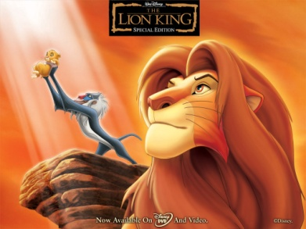
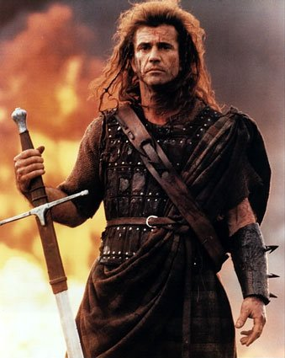
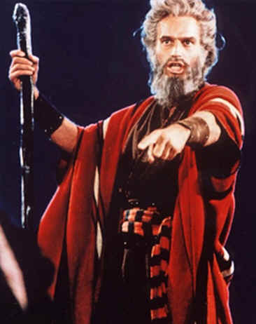
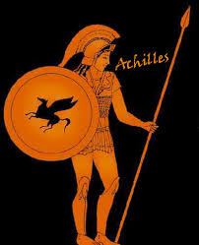
Hero Quest Pattern
Joseph Campbell, Hero with a Thousand Faces
The Monomyth
Special birth (Danger, orphan, royalty, thought dead)
leaves home and lives with others
A traumatic event leads to adventure. A herald calls hero
to adventure.
The hero has a unique weapon. It only works for him
helped by supernatural forces
Faces many trials. Proves self again and again. Faces self.
The Journey into hell, Unhealable Wound, scar,
Atones for sins of the father
When the hero dies, he is rewarded spiritually

Slide 20
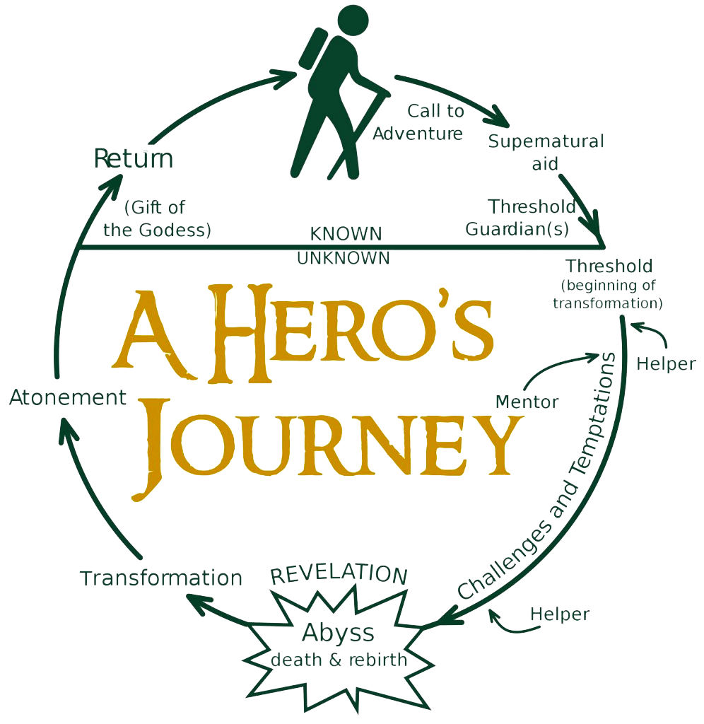

Slide 21
Nation Building: The Law
Exodus 20-23, 32-34
(Leviticus 19)
(Numbers 1-2)
(Deuteronomy 5-11)

Slide 22
4 Key verbs/ideas in the laws
Redeem: to buy back; to free
Redeemed from Egypt
Redeem your first born son
Slaves can be redeemed by a near kinsman (a close relative)
Sanctify: to set apart as sacred; to purify
Sanctify yourselves
Sanctified by my [God’s] glory
Consecrate: to dedicate to God (Ex 19:10-25)
Consecrate your first fruits to God
Consecrate your first born son to God
Atone: to make amends (for sin); to become reconciled; to satisfy
Offerings of atonement
You must atone for your sins
God redeemed His people from Egypt.
God sanctified the Israelites to be His people.
God asks the Israelites to consecrate their first born sons to him.
God made a way for the Israelites to atone for their sins by offering sacrifices.

Slide 23
Exodus (Drawn out) (40 chs)
Name comes from Greek.
There are two main divisions
leaving Egypt and travel to Sinai (liberation from human tyranny)
Revealing God’s law at Sinai (ethical and legal responsibility to its divine liberator)
The second part is dependent upon the first. Because, by redeeming Israelite slaves from Egypt, the Lord earns the right to “enslave” them to himself.
Because of Egyptian slavery, Israelites should be more just and empathetic (Ex 23:9)

Slide 24
Exodus (Drawn out) (40 chs)
Salvation from Egypt becomes the standard for God’s saving power ever after. The Exodus moves from being a one time event to a reoccurring one.
70 people went to Goshen at the end of Genesis
They emerge as a nation headed by God (A theocracy)
They get the rules that make them unique
Beginning of monotheism

Slide 25
What happens
12: Passover and the final plague
13: The Israelites leave: First born consecrated, festival of unleavened bread
14: Crossing the Red Sea, pursuers drowned; 15: Moses’ song
16: Manna (bread from heaven); 17: Water from rock
18: Jethro advises Moses (politics gets its start)
19: Israelites reach Mt. Sinai; people consecrated
20: The Ten Commandments; spoken by God to all
21-23: various laws and festivals spoken to Moses
24: Moses goes back up the mountain
25-31: Moses gets instructions for altar, tabernacle, and other sacred objects (receives covenant written by God’s finger 31:18)
32: The Golden Calf
33: New commitment; 34: New Tablets (made by Moses)

Slide 26
Moses’ intercession (prayer to God)
12 Moses said to the Lord, ‘See, you have said to me, “Bring up this people”; but you have not let me know whom you will send with me. Yet you have said, “I know you by name, and you have also found favour in my sight.” ¹³Now if I have found favour in your sight, show me your ways, so that I may know you and find favour in your sight. Consider too that this nation is your people.’ ¹⁴He said, ‘My presence will go with you, and I will give you rest.’ ¹⁵And he said to him, ‘If your presence will not go, do not carry us up from here. ¹⁶For how shall it be known that I have found favour in your sight, I and your people, unless you go with us? In this way, we shall be distinct, I and your people, from every people on the face of the earth.’
17 The Lord said to Moses, ‘I will do the very thing that you have asked; for you have found favour in my sight, and I know you by name.’

Slide 27
Moses Breaks the tablets
From 1956 movie “The Ten Commandments, starring Charlton Heston
From Dore’s Bible

Slide 28
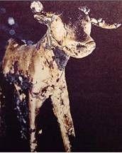
The Golden Calf (Exodus 32)
Poussin 1633: Adoration of the golden calf

Slide 29
The Ten Commandments
also called the Decalogue.
The only passage of scripture that is said to be written directly by God and spoken directly to the people. (Ex 20:1, 24:12)
The first four rules are dramatically different from those of other cultures/religions at the time.
The last rule is unique in that it goes beyond outlawing wrong action. It outlaws wrong thought.
Repeated in Deuteronomy 5:6-21

Slide 30
The Ten Commandments Exodus 20/Deut 5
I am the Lord your God, who brought you out of the land of Egypt, out of the house of slavery;
You shall have no other gods before me.
You shall not make for yourself an idol,
whether in the form of anything that is in heaven above, or that is on the earth beneath, or that is in the water under the earth. 5You shall not bow down to them or worship them; for I the Lord your God am a jealous God, punishing children for the iniquity of parents, to the third and the fourth generation of those who reject me, 6but showing steadfast love to the thousandth generation of those who love me and keep my commandments.
You shall not make wrongful use of the name of the Lord your God,
for the Lord will not acquit anyone who misuses his name.
Remember the Sabbath day, and keep it holy.
9For six days you shall labor and do all your work. 10But the seventh day is a Sabbath to the Lord your God; you shall not do any work—you, your son or your daughter, your male or female slave, your livestock, or the alien resident in your towns. 11For in six days the Lord made heaven and earth, the sea, and all that is in them, but rested the seventh day; therefore the Lord blessed the Sabbath day and consecrated it.

Slide 31
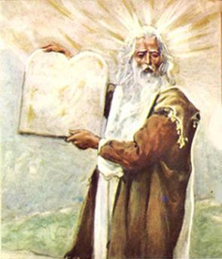
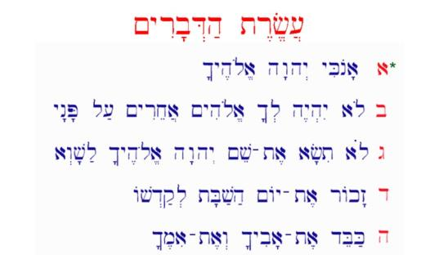
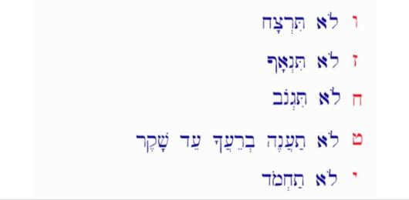
The Ten Commandments Exodus 20/Deut 5
Honor your father and your mother,
so that your days may be long in the land that the Lord your God is giving you.
You shall not murder.
You shall not commit adultery.
You shall not steal.
You shall not bear false witness against your neighbor.
You shall not covet
your neighbor’s house; you shall not covet your neighbor’s wife, or male or female slave, or ox, or donkey, or anything that belongs to your neighbor.

Slide 32
Did Moses have horns?
When Moses descended from Sinai the second time, the Torah tells us “the skin of his face was radiant” (Exodus 34:30). To protect the people from his glowing aura, Moses wore a veil at all times, except when teaching Torah.
The Hebrew word meaning to be radiant or cast a glow which is used in the above-quoted Biblical passage is “karan.” When
Jerome’s Vulgate, the standard Latin translation of the Bible, was composed in the 5th century CE, Jerome took the verb “karan” to be a literal form of the noun “keren” which means a horn.
So rather than meaning, “to emit rays,” he understood it to mean “to grow horns.”
(A classic translation error: focusing on the details without enough thought about the context)
Michelangelo’s Moses (1516)

Slide 33
Exodus 20-24: first laws
20: Ten Commandments (thunder lightning, trumpet, smoke)
20:22-23: Laws regarding
Alter: use only natural stones, not cut, in places God shows
Slaves: rules for their protection. Not permanent
Violence: “Eye for eye, tooth for tooth” (21: 24)
Property & Restitution: Responsibility
Social & Religious: no bestiality, be good to foreigners.
Justice: impartial to social status, animal rights
Sabbath, Sabbatical: rest in seventh year, land, slaves, work
24: Moses on the Mountain with Joshua 40 days & 40 nights.

Slide 34
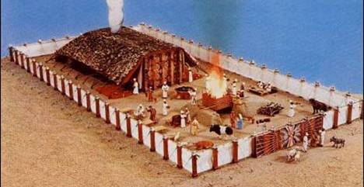
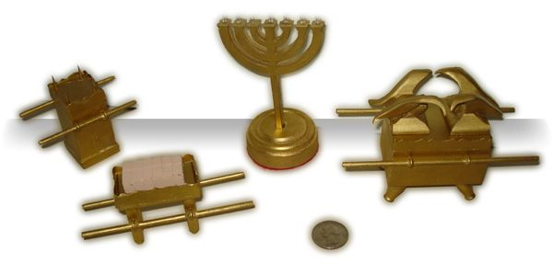
Exodus 25-34: Special Objects
25: Ark of the Covenant, with table and lamp stand.
26-27: The Tabernacle. Size, furnishings, altar
28: Priest’s clothing with special breastplate
29: Ordination of priests and offerings
30: More furnishings for the tabernacle
31: Sabbath laws, weekly
32: The Golden Calf. The most ridiculous excuse ever!!
The stone tablets. The only thing God has ever written (vs. 16), and Moses broke them.
33: Leave Sinai, but God less close, speaks only to Moses.
Moses sees God’s back side.
34: New Tablets, Moses wrote (vs 28). Moses’ face shines.

Slide 35
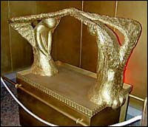
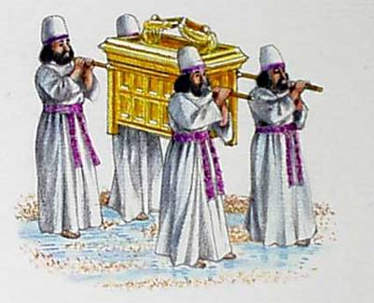
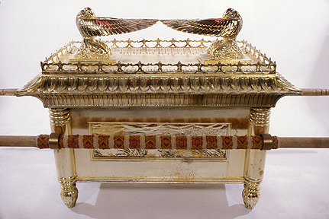
The Ark of the Covenant
Exodus 25 describes the design for its construction. It was a sacred container containing.
Stone tablets of the Ten Commandments
Aaron's rod
A little bit of manna
God’s presence was between the cherubim in “the mercy seat” (where he communicated with Moses (Exodus 25:22)

Slide 36
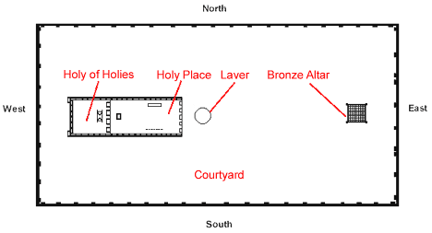
The Tabernacle
Exodus 25-30 describes specific rules for its construction.
It was a mobile temple within which sacrifices were carried out.
The ark rested in the “Holy of Holies” or The most holy place.
It was moved by the Levites from camp to camp during their 40 years in the wilderness. Solomon finally built a permanent temple to replace the tabernacle.

Slide 37
The tabernacle in more detail

Slide 38
Leviticus (Be Holy) (27 chs)
It’s early Hebrew name = “the priest’s manual” (priests were a special section of Levites under Aaron)
The purpose of Leviticus is to lay out the laws that will ensure sanctity for both everyday life and the Tabernacle.
By observing all these rules, the Israelites will remain distinct and different from the Gentile nations that would like to absorb them.
It describes the construction of the sacred objects used in rituals (the tabernacle, its contents, priestly clothing)
Teaches the difference between what is holy and common, clean vs. unclean.
An ethical element in Leviticus helps show moral reasons behind the ritual acts.
Priests were like military chaplains. They had lots of physical responsibilities. Such as determining who was sick or not, and they carried out the second part of all sacrifices. Like prophets, they were in between god and common people.
Prophets offer a link by speaking between God and man
Priests offer a link through ritual performance

Slide 39
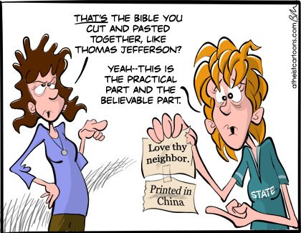
Leviticus 19: Holiness
19:2 “You shall be holy, for I the Lord your God am holy.”
Imitate God. Be like God. But how?
“you shall love your neighbor as yourself” (vs. 18)
“you shall love the alien as yourself, for you were aliens in the land of Egypt.” (vs. 34)
Various other laws show how to be like God
Idols, food, agriculture, relations with neighbors, judging fairly, slander, honesty, purity, faithfulness, respect toward elders, food, witchcraft, sexual relations, and more.

Slide 40
Numbers (40 years in the wilderness) (36 chs)
Hebrew title, “Benidbar” means “in the wilderness.”
Shows the laws in action as the camp is in motion (rules pertaining to Levites in general)
Lack of faith (13-14) leads to the destruction of the exodus generation.
The new generation looks forward to Canaan, rather than backward to Egypt.
Ch 1 & Ch 26: Two censuses; one is the exodus generation the other is the wilderness generation.
The new generation is disciplined and taught in wilderness in preparation for occupying the promised land.
They learn God’s laws while separate from others.
They toughen up.
Only an obedient Israel can fully enjoy God’s promises.

Slide 41
Numbers 1-2
Census taken of fighting men to prepare for war because of plan to take the promised land. Set to leave Mt. Sinai.
Levi’s tribe not counted because they are priests
Joseph’s tribe split in half to compensate (Ephraim and Manasseh)
Order and arrangement of the tribes is important.
603,550 fighting men (2:32)

Slide 42
Other stories in Numbers
11: Manna and quails
12: Aaron and Miriam defy Moses and get leprosy.
13: 12 spies sent to Canaan.
Bring huge cluster of grapes and fear it is impossible to conquer
Joshua and Caleb still trust God, but to no avail
God punishes by forcing them to spend 40 years wandering in desert
Everyone from that general will die except Joshua and Caleb
15: Death to man who gathers sticks on Sabbath
16: Korah’s rebellion
20: Water from rock & Moses punished
21: Bronze serpent that heals snakebites.
22: Balaam’s talking donkey

Slide 43
Deuteronomy (poised to enter 40 years later) (34 chs)
In Greek, the name means “second lawgiving”
It remembers Israel’s past and prepares for its future: A pivotal position, both literarily and theologically.
It is written in the form of Moses giving three farewell speeches, speaking directly to the people.
Moses is eloquent. (Unlike in Exodus when he needs Aaron to speak for him.)
Obedience brings prosperity and divine protection while disobedience brings national defeat and death.
In style and theological outlook, Deuteronomy is connected to the historical books that follow.
It is more humane than other parts of the Torah. It stresses The Lord’s steadfast love and the people’s moral obligation. Emphasizes social justice, personal ethics, neighborly responsibilities.

Slide 44
Deuteronomy repeated phrases
With all your heart and soul
In order that it may go well with you
Be thankful
In a place he himself will choose
A land where milk and honey flow. (A land flowing with milk and honey. KJV)
If only you obey the voice of the Lord your God
Chapter 5
10 commandments repeated

Slide 45
Deuteronomy key verses
6:3 – Hear, therefore, O Israel, and observe them diligently, so that it may go well with you, and that you may multiply greatly in a land flowing with milk and honey, as the Lord, the God of your ancestors, has promised you.
6:4 – Hear, O Israel: The Lord is our God, the Lord alone. You shall love the Lord your God with all your heart, and with all your soul, and with all your might.
7:7 It was not because you were more numerous than any other people that the Lord set his heart on you and chose you—for you were the fewest of all peoples. It was because the Lord loved you and kept the oath that he swore to your ancestors, that the Lord has brought you out with a mighty hand, and redeemed you from the house of slavery, from the hand of Pharaoh king of Egypt.
7:18 Do not be afraid of them. Just remember what the Lord your God did to Pharaoh and to all Egypt.

Slide 46
What Does God Want?
10: 12-18 So now, O Israel, what does the Lord your God require of you? Only to fear the Lord your God, to walk in all his ways, to love him, to serve the Lord your God with all your heart and with all your soul, ¹³and to keep the commandments of the Lord your God and his decrees that I am commanding you today, for your own well-being. ¹⁴Although heaven and the heaven of heavens belong to the Lord your God, the earth with all that is in it, ¹⁵yet the Lord set his heart in love on your ancestors alone and chose you, their descendants after them, out of all the peoples, as it is today. ¹⁶Circumcise, then, the foreskin of your heart, and do not be stubborn any longer. ¹⁷For the Lord your God is God of gods and Lord of lords, the great God, mighty and awesome, who is not partial and takes no bribe, ¹⁸who executes justice for the orphan and the widow, and who loves the strangers, providing them with food and clothing.

Slide 47
The Deuteronomic Covenant
11:26 – 26 See, I am setting before you today a blessing and a curse: ²⁷the blessing, if you obey the commandments of the Lord your God that I am commanding you today; ²⁸and the curse, if you do not obey the commandments of the Lord your God, but turn from the way that I am commanding you today, to follow other gods that you have not known.
(There’s nothing in between)

Slide 48
Love? A unique approach
Leviticus 19:18-19
You shall not hate in your heart anyone of your kin; you shall reprove your neighbor, or you will incur guilt yourself. You shall not take vengeance or bear a grudge against any of your people, but you shall love your neighbor as yourself : I am the Lord.
Deuteronomy 6:4-5
Hear, O Israel: the Lord is our God, the Lord alone. You shall love the Lord your God with all your heart, and with all your soul, and with all your might.
Keep these words that I am commanding you today in your heart. Recite them to your children and talk about them when you are at home and when you are away, when you lie down and when you rise. Bind them as a sign on your hand, fix them as an emblem on your forehead, and write them on the doorposts of your house and on your gates. (6-9)

